Slide 1


Intelligent Methods, Systems, and Applications
(IMSA)
An End-to-End Arabic Text Correction Framework:
Comparing Custom Character-Level Transformers
and Pre-trained AraBART
Mohamed Soltan
Abdelmonem Hatem
Mohamed Taha
Youssef Khalaf
Dept. of Computer Science
MSA University
Dept. of Computer Science
MSA University
Dept. of Computer Science
MSA University
Dept. of Computer Science
MSA University
October University for Modern Sciences and Arts (MSA)
Cairo, Egypt
IEEE / IMSA 2026
Notes:
Good morning. We present an end-to-end Arabic text correction framework comparing a compact custom Transformer with a pre-trained AraBART multi-modal service.

Slide 2
Outline
• Introduction & Motivation
• Problem Statement & Soft Errors
• Related Work & Research Gap
• Proposed End-to-End Framework
• Data, Normalization & Noise Injection
• Custom Transformer Architecture
• AraBART Multi-modal Deployment
• Experiments, Metrics & Baselines
• Results, Error Analysis & Discussion
• Conclusion & Future Work
Notes:
Walk through the agenda briefly. Emphasize the two-path story: controlled benchmarking vs. real-world deployment.

Slide 3
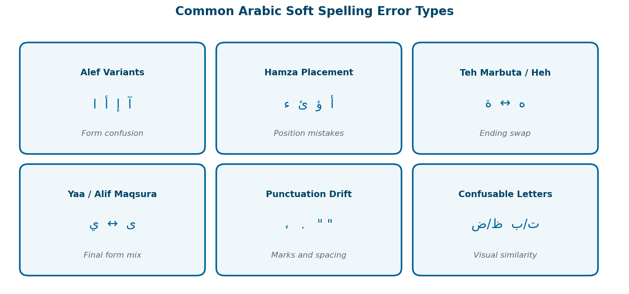
Introduction
• Arabic text correction is critical for education, media QA, accessibility, and moderation.
• Challenges: orthographic variants, visually confusable letters, optional diacritics, and spacing that changes meaning.
• OCR and ASR add broken words, missing characters, merged tokens, and repeated substitutions.
• Core design question: compact task-specific model vs. larger pre-trained Arabic model?
• This work studies that trade-off with two complementary correction paths.

Slide 4
Motivation
OCR Noise
ASR Noise
Broken tokens, substitutions, and spacing errors from scanned Arabic documents.
Speech transcripts introduce phonetic and boundary mistakes.
Typing Soft Errors
Deployment Gap
Alef/Hamza/Teh Marbuta confusions are frequent and meaning-changing.
Most Arabic studies report scores, few ship multi-modal user-facing systems.

Slide 5
Problem Statement
• Small character-level errors in Arabic can change meaning, break token boundaries, or reduce grammatical fluency.
• Correction is more than dictionary lookup — it needs sequence context at character and sentence levels.
• Existing resources often lack controlled noisy-clean pairs tailored to modern Arabic news orthography.
• Benchmarks alone are insufficient: real systems must also handle OCR images, audio, and live speech.
• Goal: a reproducible end-to-end workflow covering data curation, noise synthesis, training, evaluation, and deployment.

Slide 6
Arabic Soft Error Categories
Guided by learner studies, social-media patterns, and editor correction logs (~85% of common Arabic spelling errors).

Slide 7
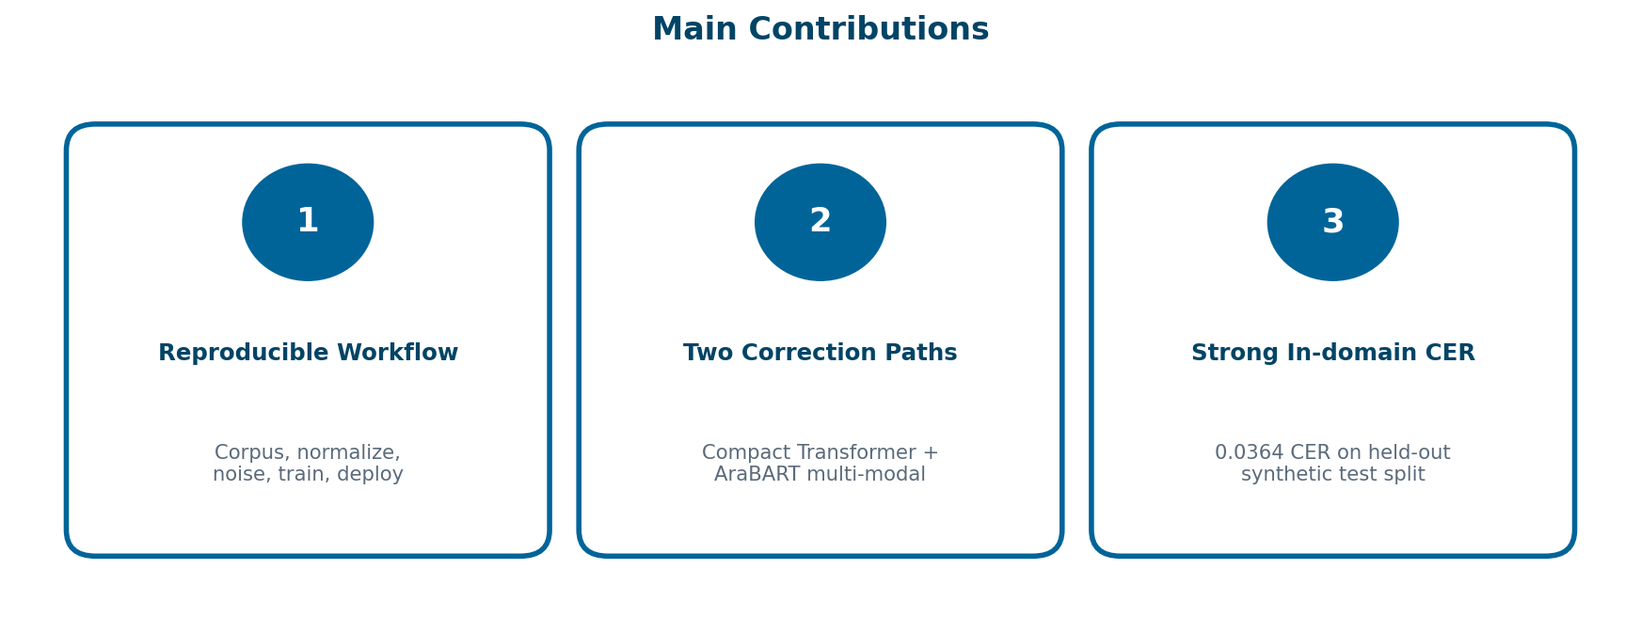
Contributions

Slide 8
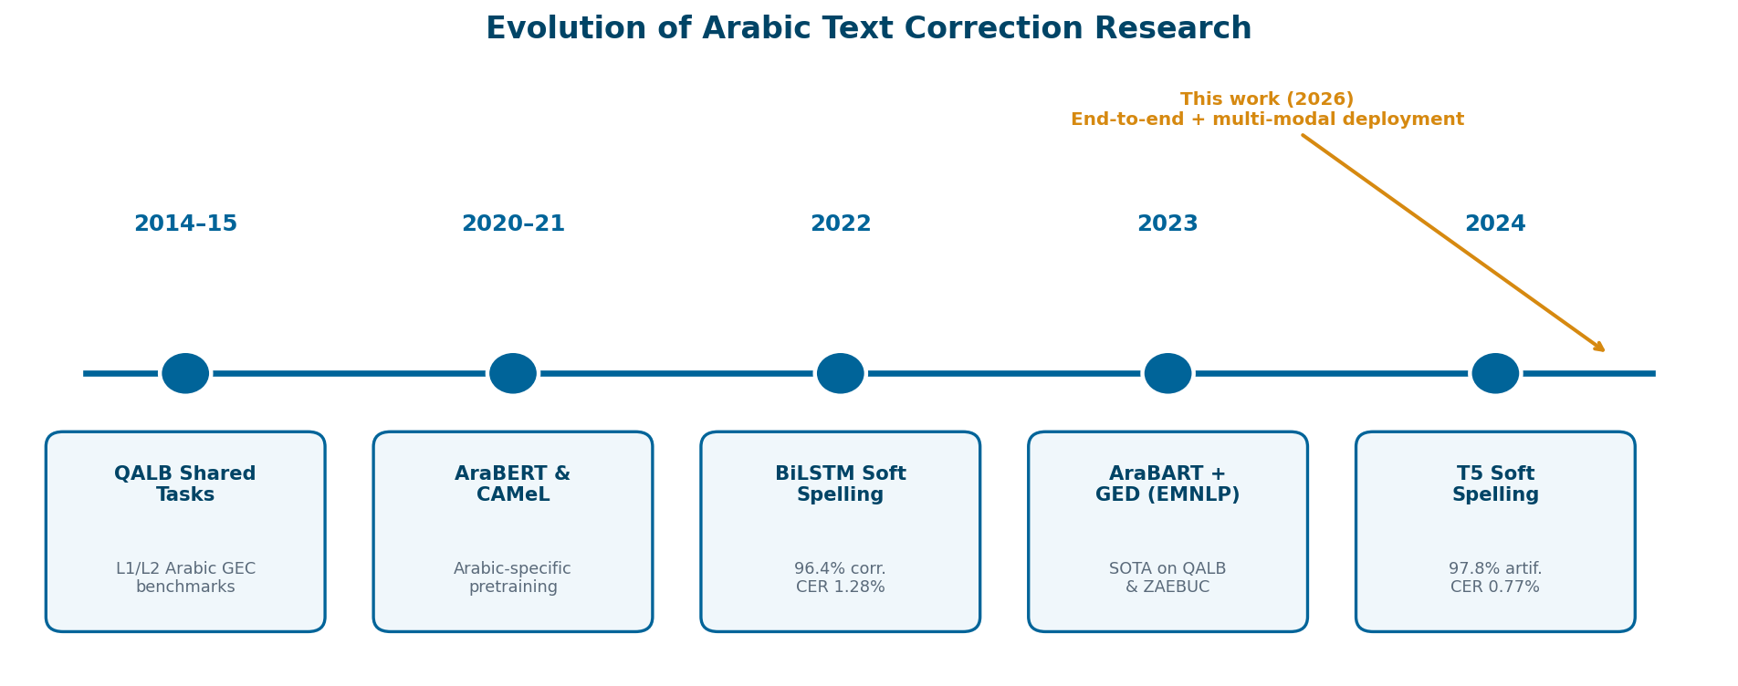
Related Work — Research Timeline
Notes:
Trace the field from QALB shared tasks to BiLSTM, AraBART+GED, and T5 soft spelling — then introduce our end-to-end deployment contribution.

Slide 9
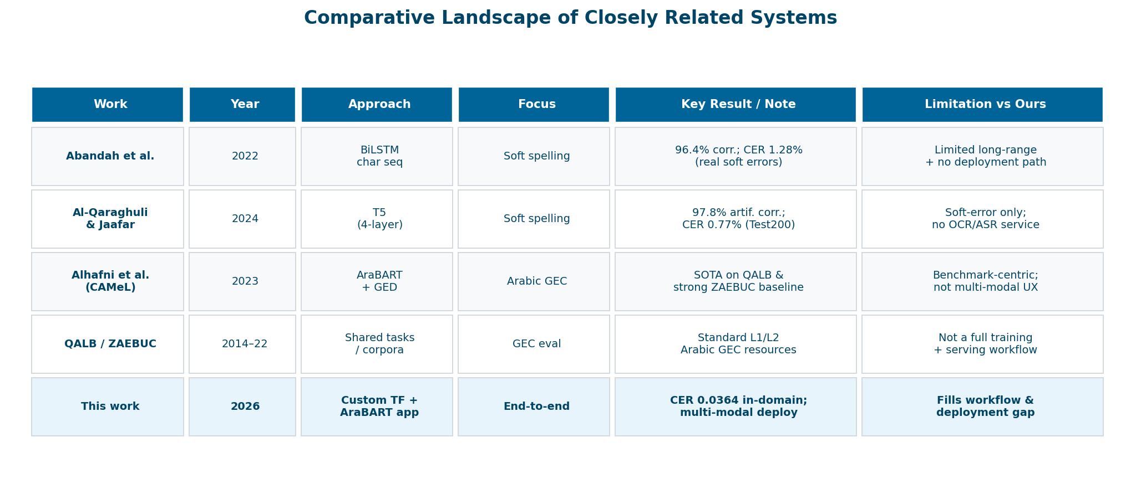
Related Work — Comparative Landscape
Notes:
Highlight Abandah BiLSTM (CER 1.28%), Al-Qaraghuli T5 (CER 0.77% on Test200), and Alhafni AraBART+GED SOTA on QALB. Emphasize that none deliver our full multi-modal workflow.

Slide 10
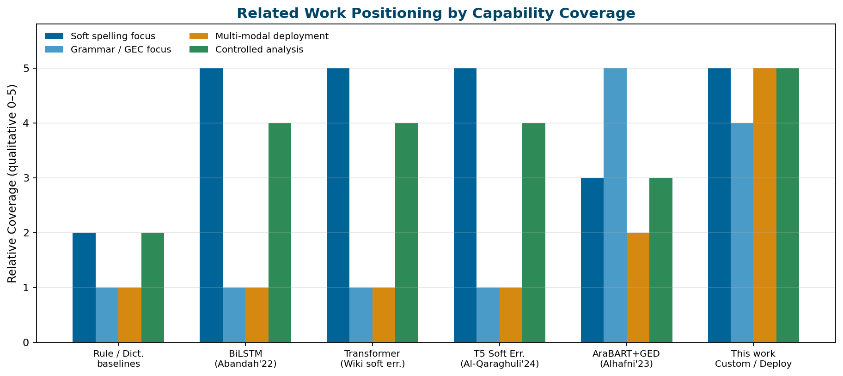
Related Work — Capability Positioning
Qualitative coverage view: prior systems are strong on soft spelling or GEC, but weak on multi-modal deployment + controlled end-to-end analysis together.

Slide 11
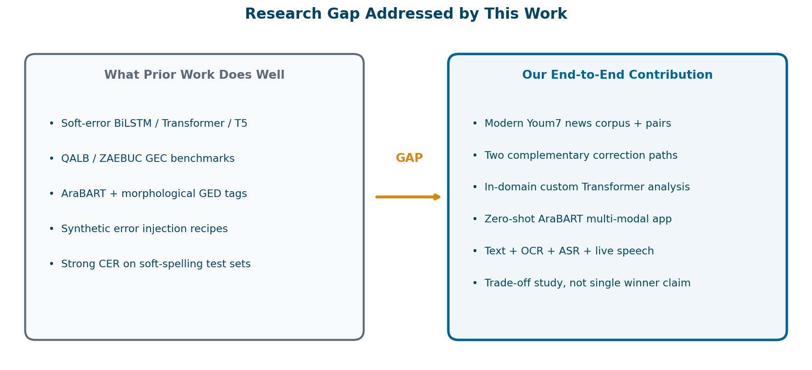
Research Gap
Notes:
Prior art solves pieces of the problem. Our gap fill is the reproducible workflow that couples controlled modeling with OCR/ASR deployment.

Slide 12
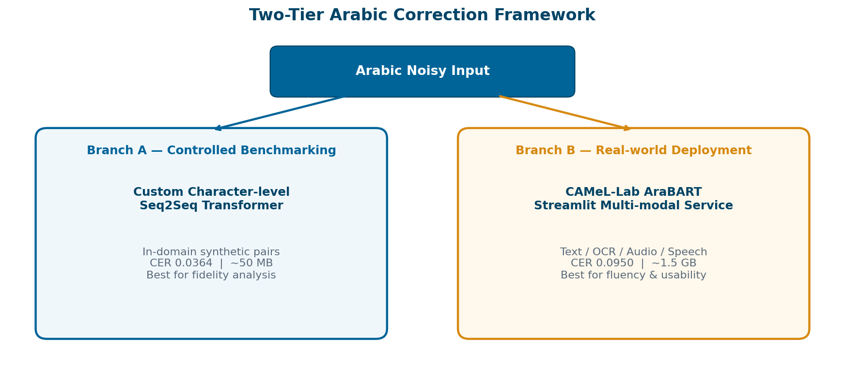
Proposed Framework Overview
Notes:
This is the key conceptual slide: Branch A optimizes controlled character fidelity; Branch B optimizes real-world multi-modal usability.

Slide 13
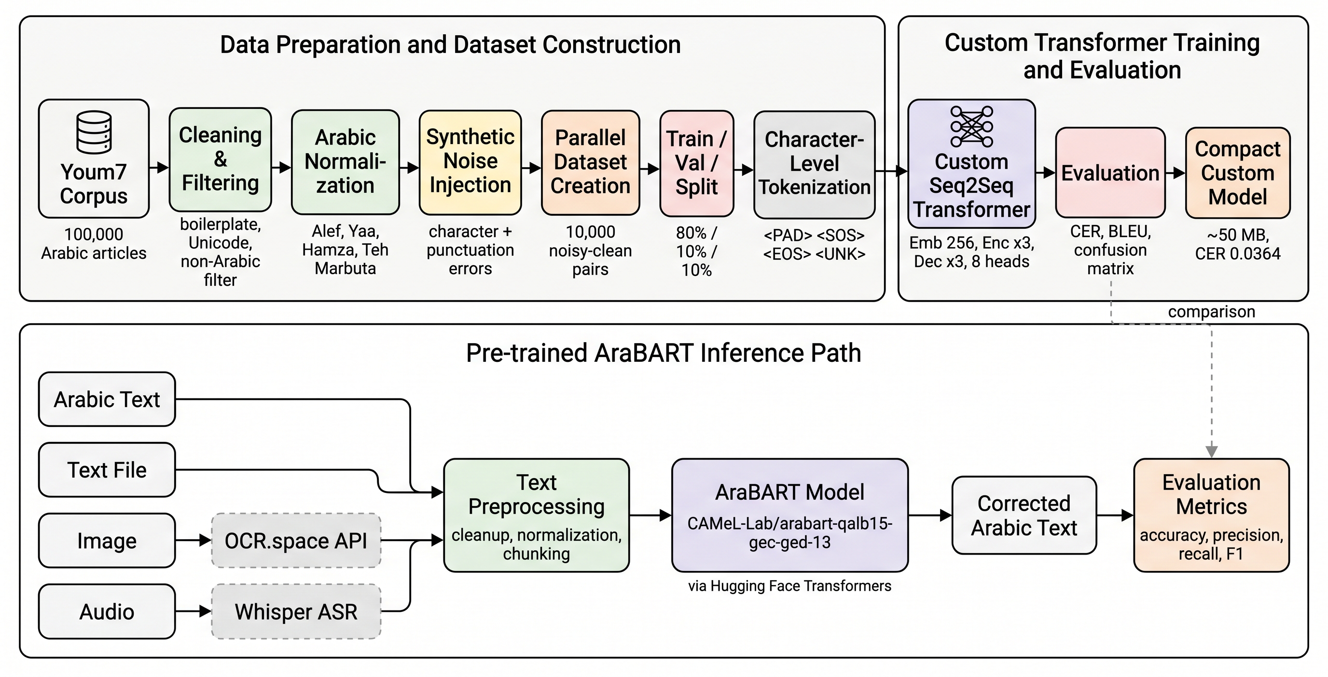
End-to-End Pipeline
Shared data path splits into Branch A (custom Transformer) and Branch B (AraBART multi-modal service).
Notes:
Walk left-to-right: Youm7 corpus, cleaning, normalization, synthetic noise, then the two branches.

Slide 14
Correction Examples
Noisy
Clean
اعلنت كليه الصيدله عن مواعبد التسجيل
→
أعلنت كلية الصيدلة عن مواعيد التسجيل
Teh Marbuta / Heh + Alef + letter swaps
Noisy
Clean
انلقت مبادرة مدارس النيل المصرية الودلية
→
انطلقت مبادرة مدارس النيل المصرية الدولية
Dropped / substituted characters
Noisy
Clean
هزا كتاب مفيد
→
هذا كتاب مفيد
Visual soft substitution

Slide 15
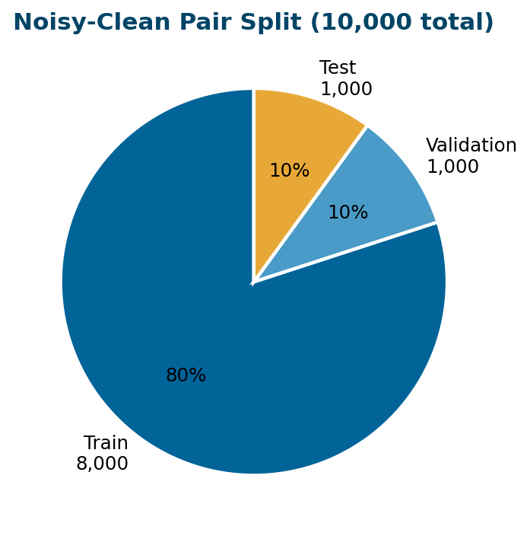
Data Acquisition & Curation
• Scraped Youm7 Arabic news with async aiohttp + BeautifulSoup.
• Polite crawling: 1–3s randomized delays, retries, robots.txt compliance.
• Filters: remove boilerplate, short articles, and samples with >15% non-Arabic.
• Final clean corpus: 100,000 high-quality articles (news, education, health, tech).
• Prepared 10,000 noisy-clean pairs for controlled modeling.
• Split: 8,000 train / 1,000 val / 1,000 held-out test.

Slide 16
Arabic Corpus Context
Dataset | Scale | Source | Use / Availability
Youm7 (this work) | 100,000 | Youm7 Egypt | Noisy-clean generation / Private
SANAD | 194,797 | AlKhaleej+ | Classification / Public
Ultimate Arabic News | 193,000 | Multiple outlets | General NLP / Public
ANAD | 500,000 | 12 news sites | Annotated news / Public
Amina | ~1.85M | Regional newspapers | Multimodal metadata / Public
Wiki-40B (AR) | ~1M+ | Arabic Wikipedia | Language modeling / Public

Slide 17
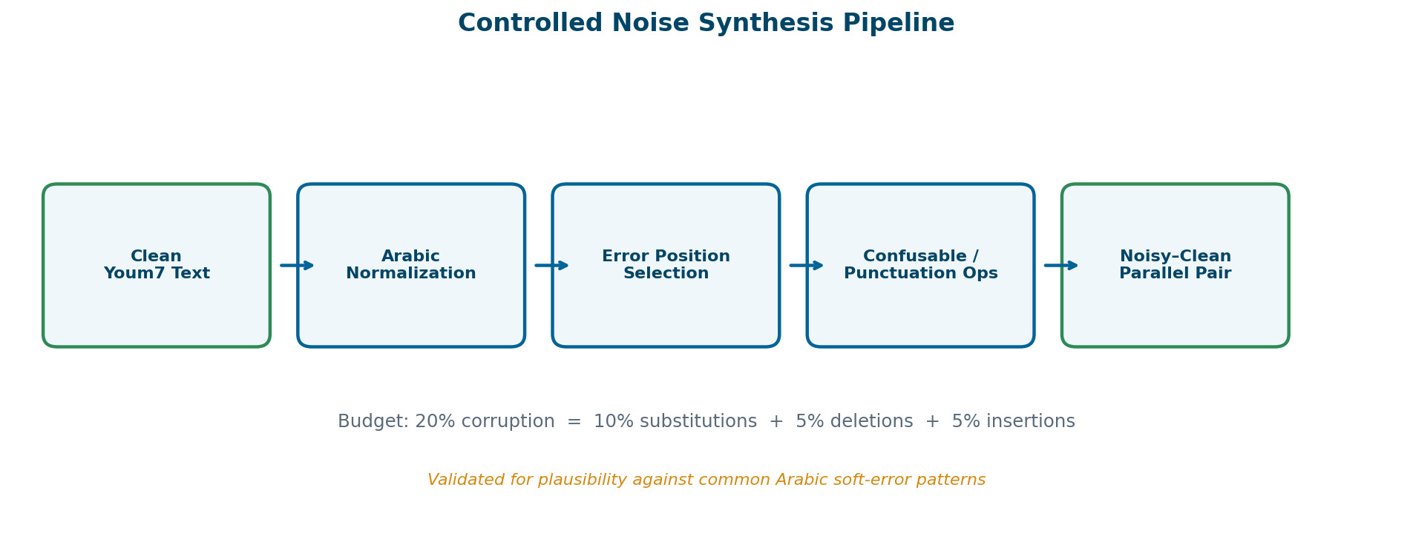
Normalization & Noise Injection
Deterministic normalization + 20% corruption budget enables reproducible character-level supervision.

Slide 18
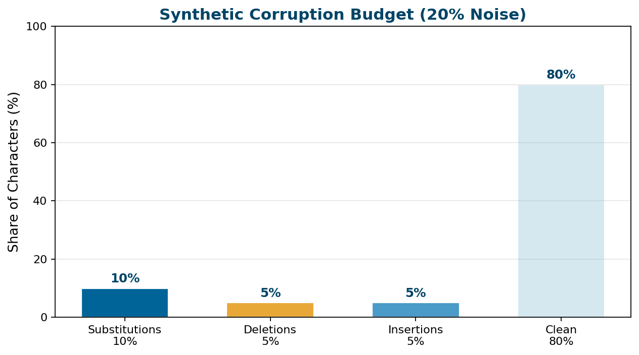
Corruption Budget & Soft Categories
• 10% substitutions from confusable maps
• 5% deletions + 5% insertions
• Keyboard-adjacency & punctuation drift
• Hamza/Alef, Teh Marbuta–Heh, Yaa/ى
• Spacing boundary shifts included
• Designed for typing + OCR + ASR realism

Slide 19
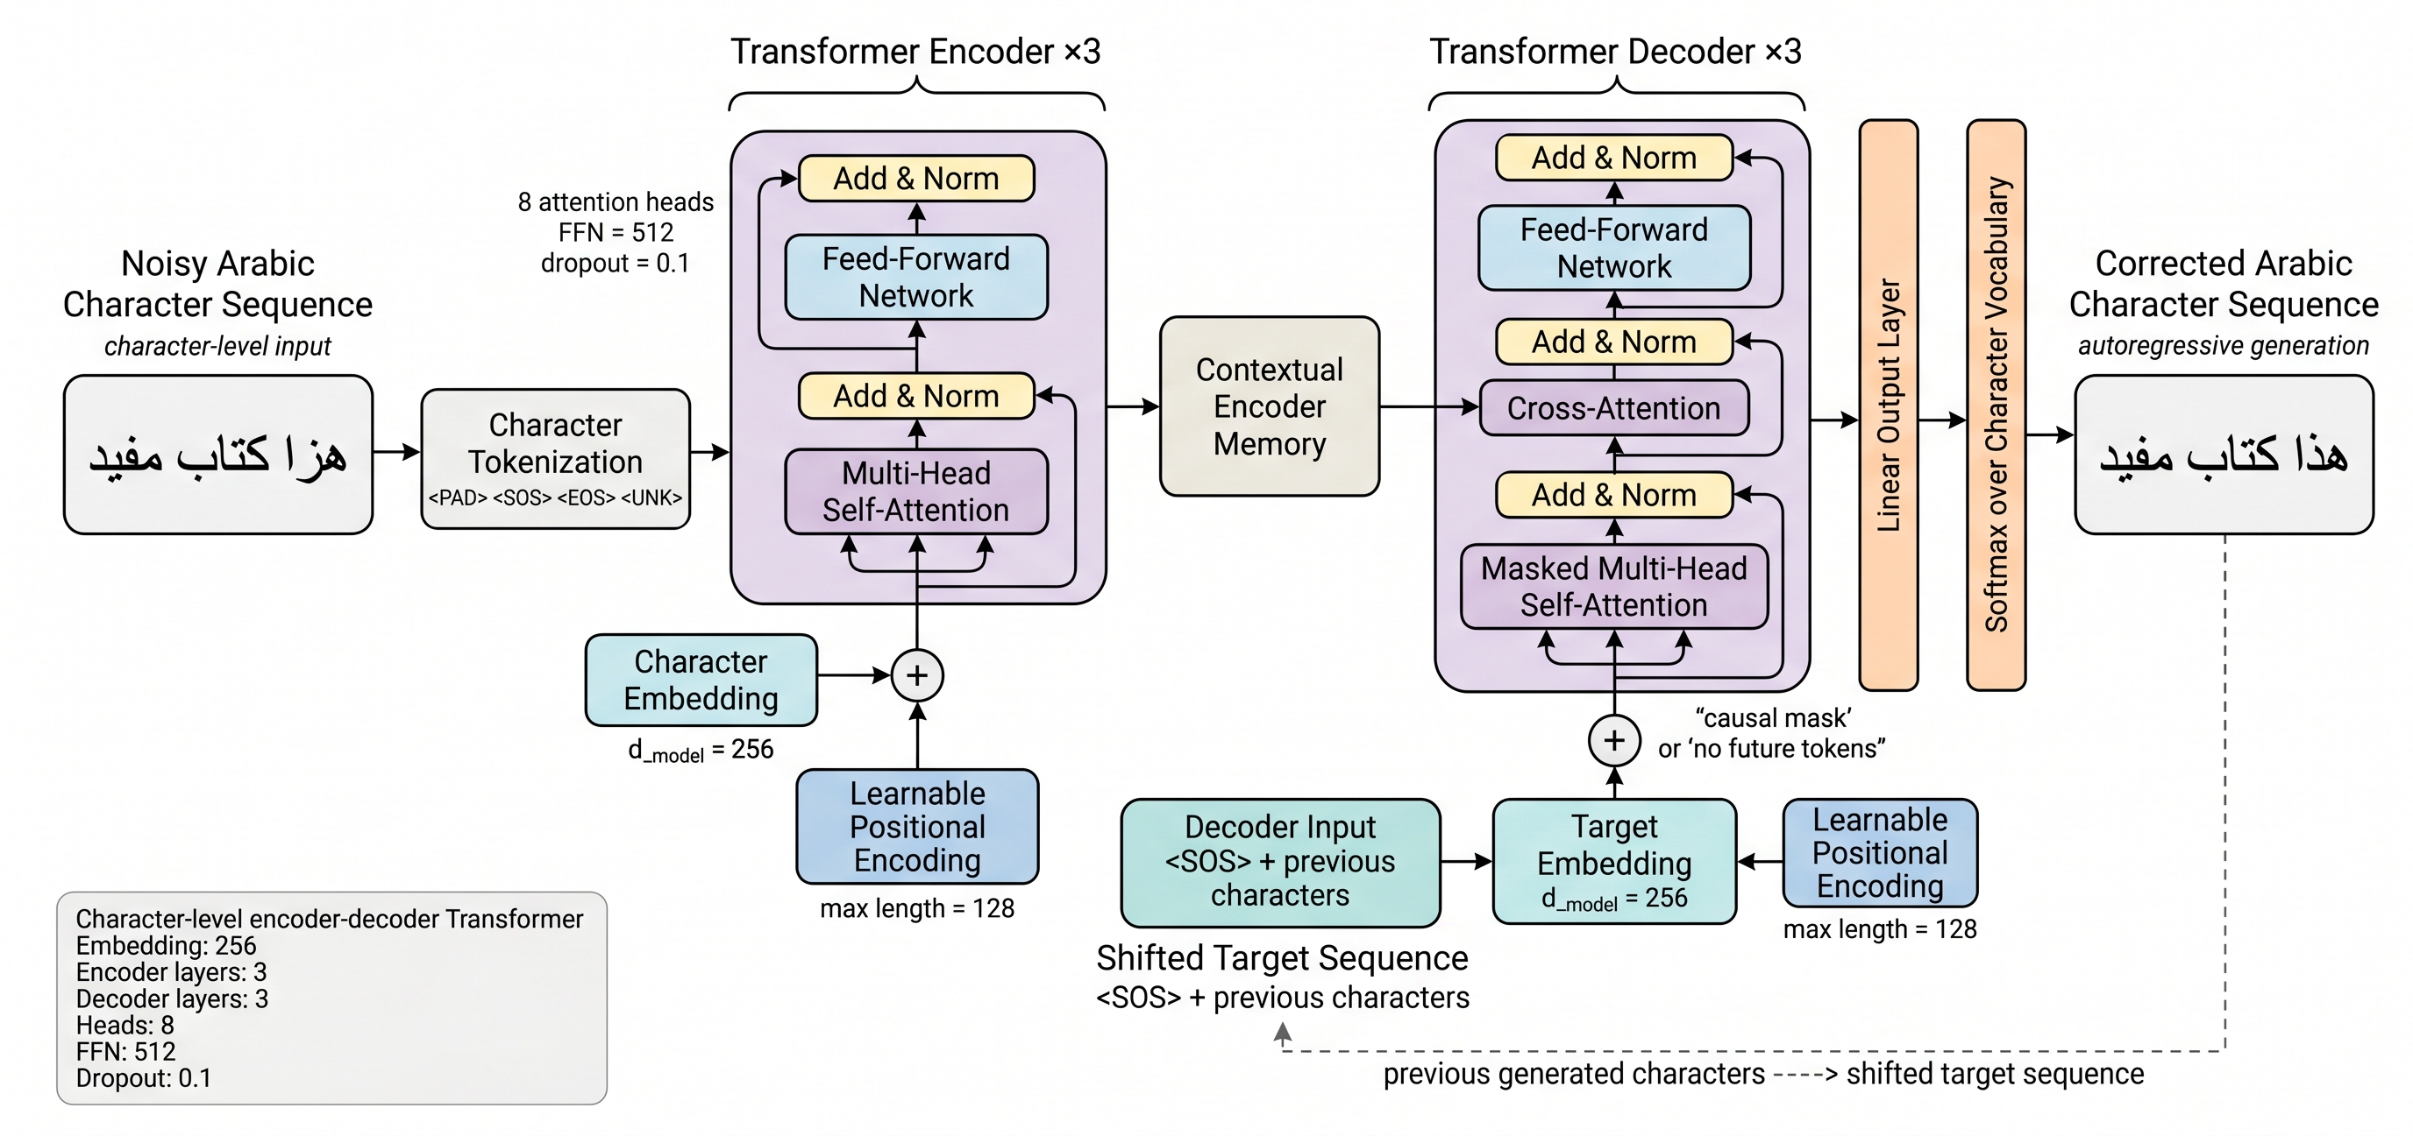
Custom Seq2Seq Transformer (Branch A)

Slide 20
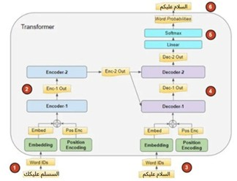
Transformer Encoder–Decoder Intuition
• Noisy Arabic → embeddings + positions
• Encoder builds contextual memory
• Decoder generates corrected chars
• Cross-attention links source ↔ target
• Softmax over character vocabulary

Slide 21
Model Configuration & Training
Architecture
Training Protocol
• Character-level encoder-decoder Transformer
• Embedding dim: 256
• Encoder / Decoder layers: 3 / 3
• Attention heads: 8
• FFN dimension: 512
• Dropout: 0.1
• Max sequence length: 128
• Optimizer: Adam (lr = 1e-4)
• Loss: sparse categorical cross-entropy
• Scheduled sampling: teacher forcing 1.0 → 0.3
• Mixed precision + checkpointing
• Batch size: 32 | Epochs: 10
• GPU training ≈ 100 minutes
• Checkpoint size ≈ 50 MB

Slide 22
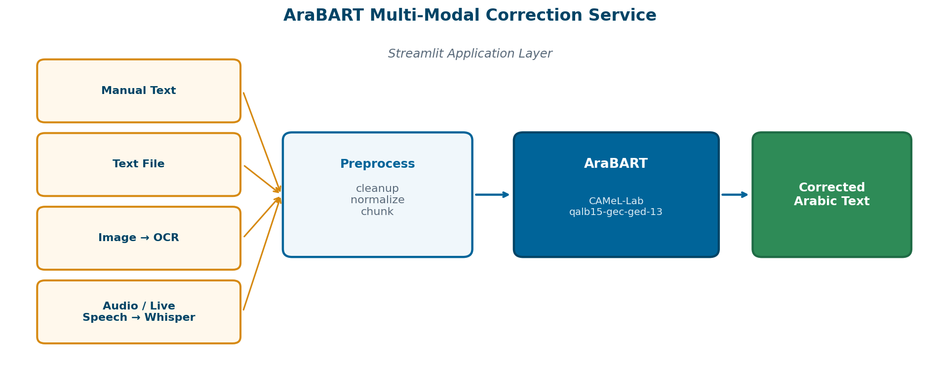
AraBART Deployment Service (Branch B)
Model: CAMeL-Lab/arabart-qalb15-gec-ged-13 via Hugging Face + Streamlit (OCR.space + Whisper).

Slide 23
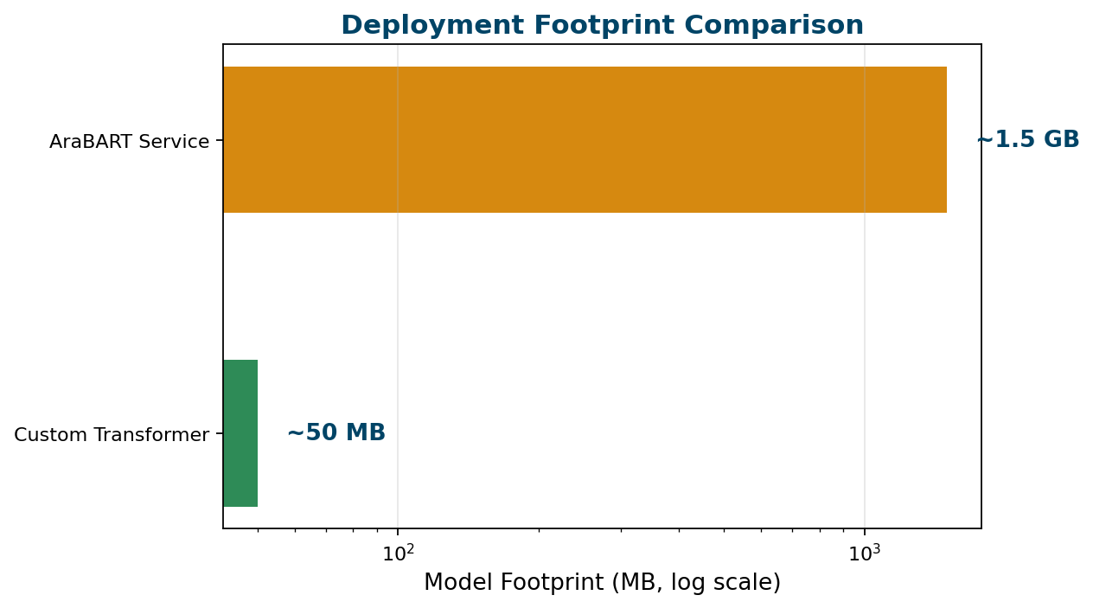
Why AraBART for Deployment?
• Pretrained Arabic seq2seq model fine-tuned for GEC/GED.
• Strong fluency on orthography + grammar-oriented edits.
• Zero-shot adoption in this study (no project fine-tuning).
• Supports text, files, OCR images, audio, and live speech.
• Trade-off: heavier footprint (~1.5 GB) vs. broader usability.
• Complements the compact custom Transformer path.

Slide 24
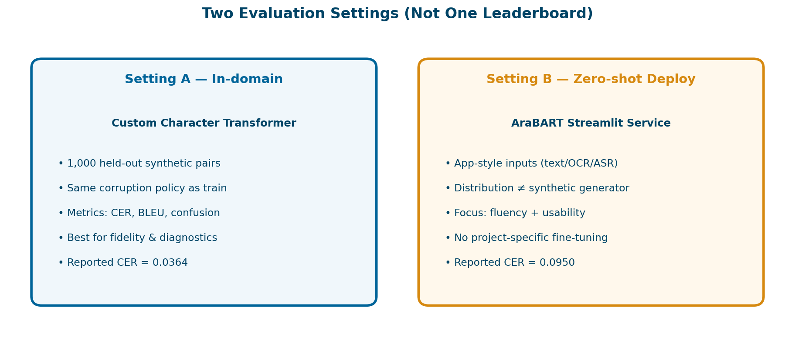
Evaluation Metrics & Protocol

Slide 25
Primary Metric: Character Error Rate
• CER suits character-level soft spelling correction.
• BLEU used as secondary lexical/sequence quality metric.
• Baselines: normalization-only + dictionary correction.
• Project reference ranges: rule-based & BiLSTM-style.
• Always report setting A and setting B separately.
CER Definition
CER = (S + D + I) / N
S = substitutions
D = deletions
I = insertions
N = reference length (characters)

Slide 26
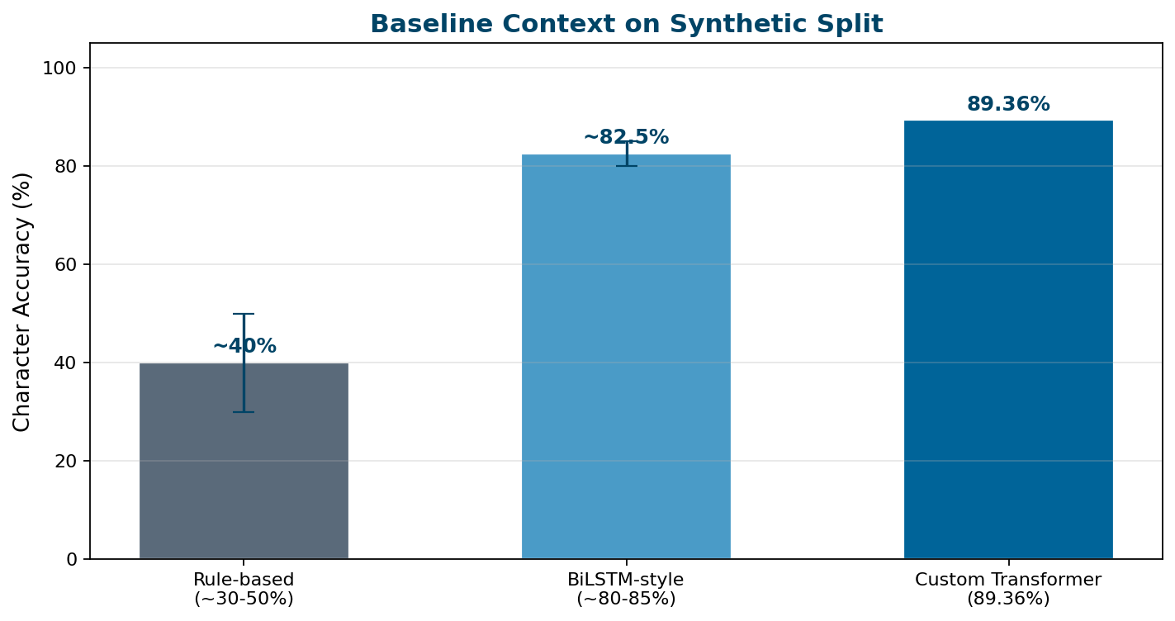
Baseline Context
Custom Transformer reaches 89.36% character accuracy on synthetic project runs — best in-domain fidelity.

Slide 27
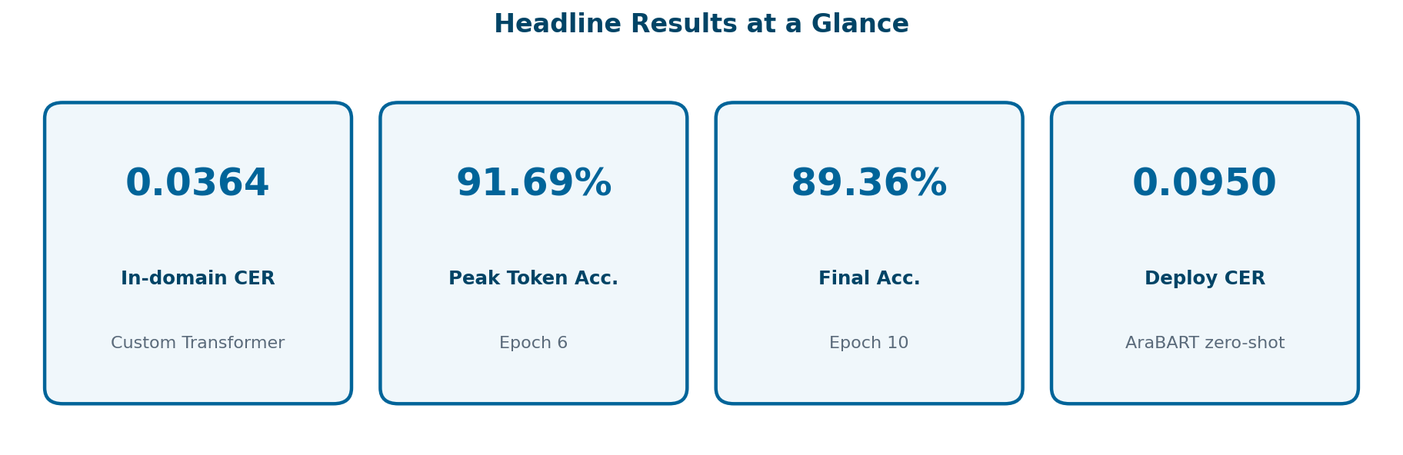
Headline Results
Read as two settings: in-domain reconstruction fidelity vs. zero-shot multi-modal deployment.

Slide 28
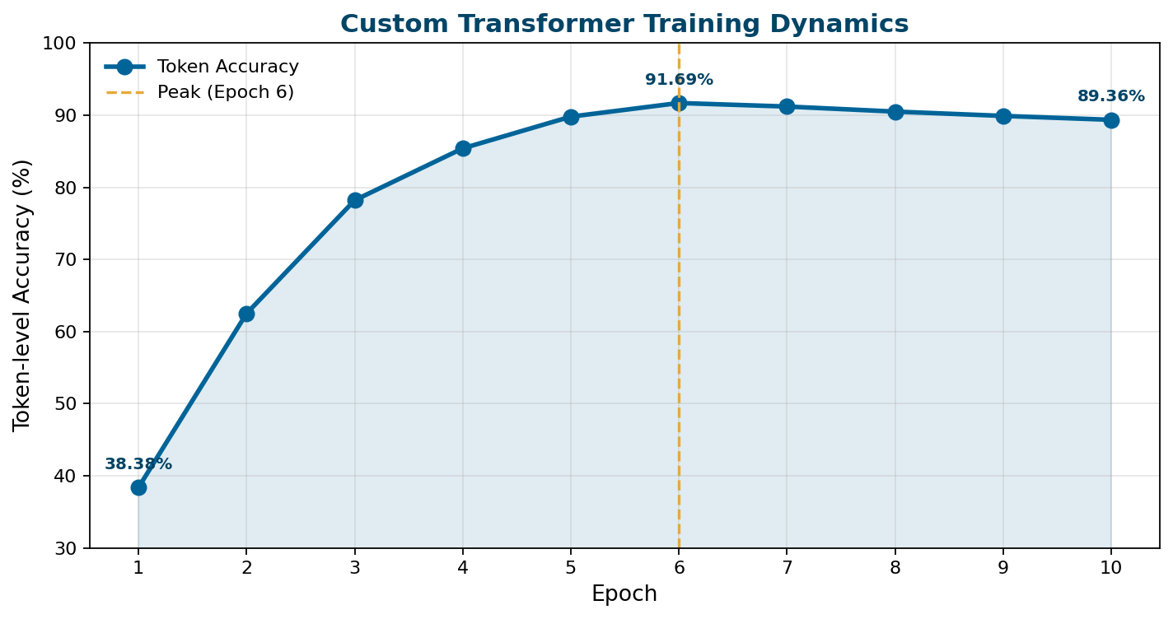
Training Dynamics
• Epoch 1: 38.38%
• Epoch 6 peak: 91.69%
• Epoch 10: 89.36%
• Fast early learning of dominant patterns.
• Later slight drop suggests mild overfitting to synthetic noise.
• Earlier stopping / stronger regularization recommended.

Slide 29
Side-by-Side Results
Attribute | Custom Transformer | AraBART Service
Setting | In-domain synthetic | Zero-shot multi-modal
Model | Char seq2seq Transformer | arabart-qalb15-gec-ged-13
CER | 0.0364 | 0.0950
BLEU | 0.292 | Not reported
Peak token acc. | 91.69% | N/A (pre-trained)
Fine-tuning | Yes | No
Training time | ~100 min GPU | Inference only
Size | ~50 MB | ~1.5 GB
Inputs | Text pipeline | Text, file, OCR, audio, speech
Notes:
Stress that these are two operating settings, not a single fair leaderboard. Custom wins CER in-domain; AraBART wins deployment breadth.

Slide 30
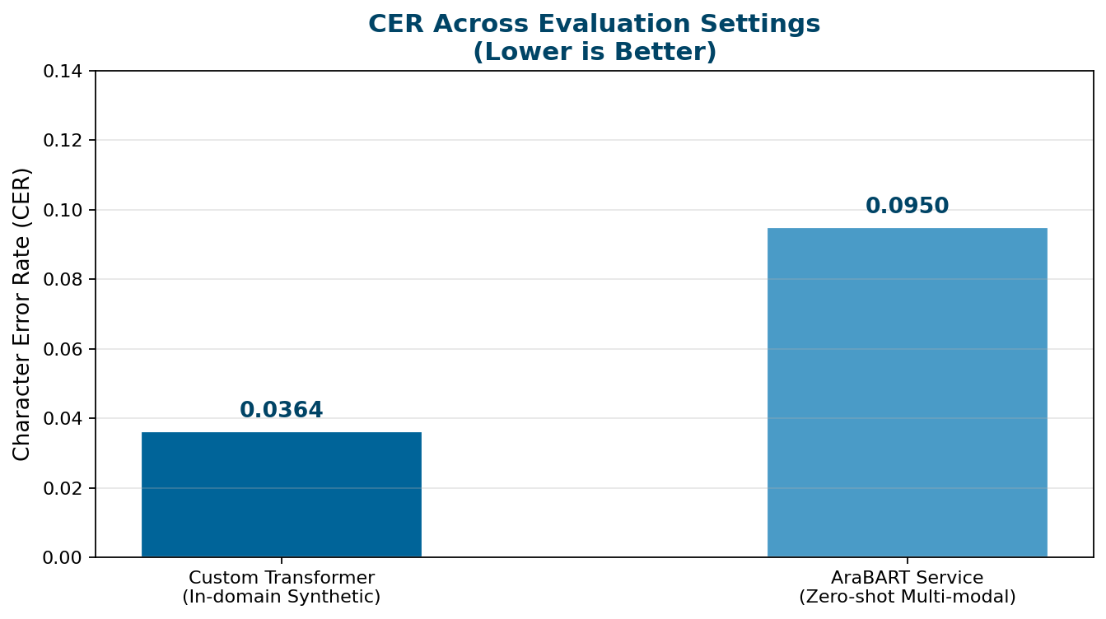
CER Comparison Across Settings
• Lower CER = better reconstruction.
• Custom model wins in-domain fidelity.
• AraBART remains preferred for fluency and multi-modal robustness.
• Not a like-for-like contest — two operating settings.

Slide 31
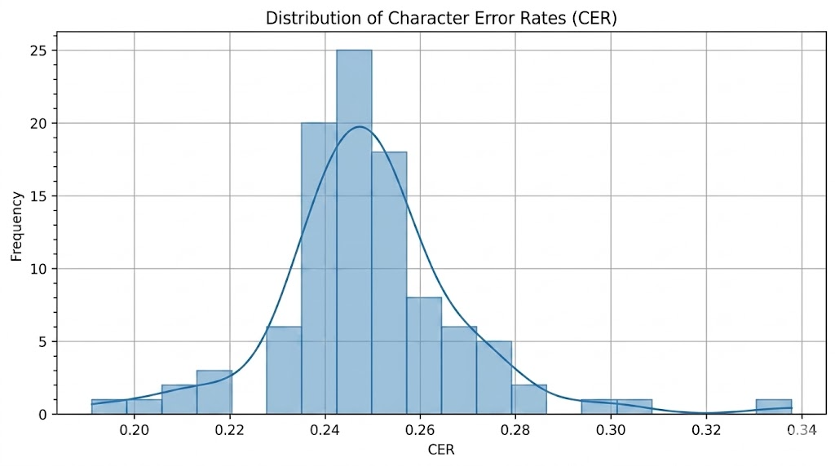
CER Distribution
• Most samples concentrate in a low-CER band.
• Indicates stable correction, not luck on a few cases.
• Right tail = heavy corruption samples.
• Useful for reliability assessment in deployment.

Slide 32
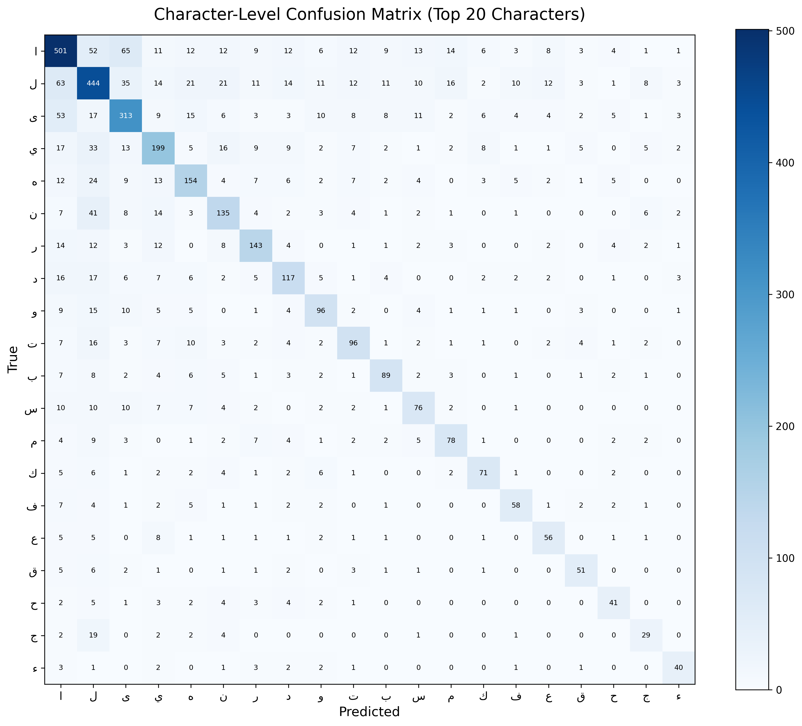
Character Confusion Matrix
• Strong diagonal = solid identity mapping.
• Off-diagonal cells reveal persistent substitutions.
• Hard cases: Alef/Hamza variants, Yaa/Alif-Maqsura, Teh Marbuta/Heh.
• Whitespace boundary errors amplify local drift.
• Guides targeted augmentation and loss design.

Slide 33
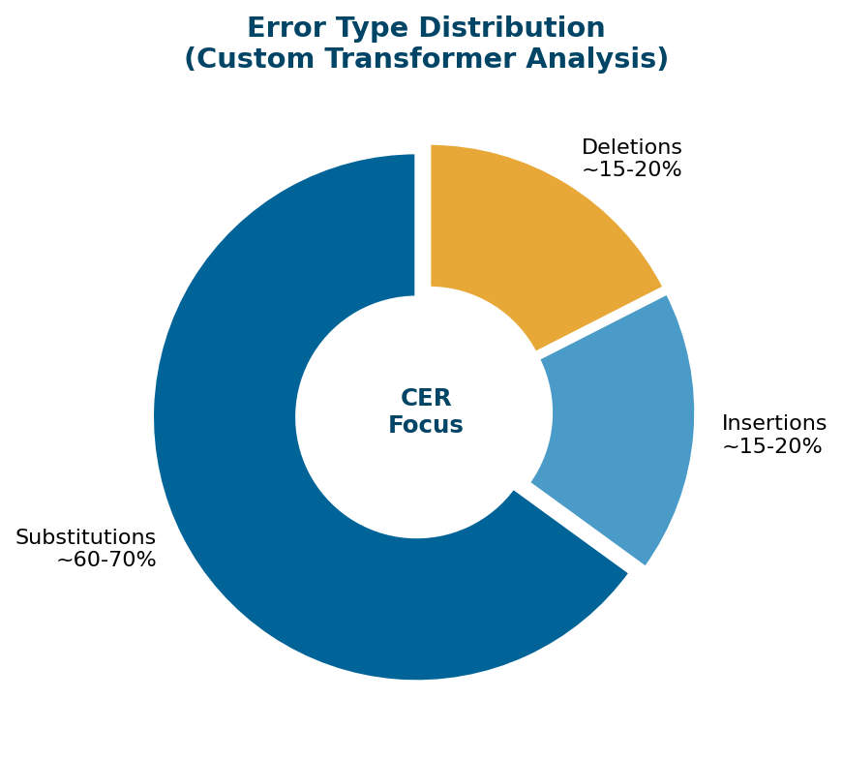
Error Analysis
• Substitutions dominate (~60–70%).
• Insertions and deletions each ~15–20%.
• Matches Arabic soft-error behavior: near-equivalent character choice.
• Future work should prioritize whitespace + Alef/Hamza contrasts.
• Curriculum / class-weighted objectives can reduce hard confusions.

Slide 34
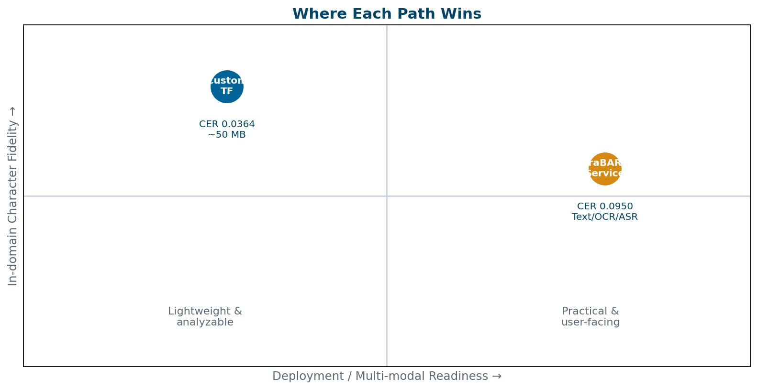
Discussion & Deployment Implications
• Custom Transformer: best fidelity + tiny checkpoint.
• AraBART: best fluency across modalities.
• Recommended production pattern: two-tier routing.
• Next: shared QALB fair comparison.

Slide 35
Conclusion
• Delivered a reproducible Arabic correction workflow: collect → normalize → synthesize → train → evaluate → deploy.
• Custom character-level Transformer: strong in-domain reconstruction (CER 0.0364, peak accuracy 91.69%).
• AraBART Streamlit service: better practical fluency across text, OCR, audio, and live speech.
• Remaining errors concentrate in whitespace and Alef/Hamza-style confusions.
• Best practice: two-tier system — compact model for control, pre-trained service for real-world use.
Notes:
Close with the two-tier takeaway and the three contribution pillars: workflow, dual paths, and strong in-domain CER.

Slide 36
Future Work
Targeted Augmentation
Regularization & Early Stop
Focus synthetic noise on Alef/Hamza, Teh Marbuta/Heh, and whitespace boundaries.
Preserve peak generalization near epoch 6 and reduce late overfitting.
Shared Benchmarks
Dialect Coverage
Fair comparison on external datasets such as QALB.
Extend to dialectal Arabic with dialect ID + focused data collection.
Grammar Layer
Confidence Estimation
Add grammar-aware detection for broader writing-support systems.
Production-ready uncertainty signals for safer corrections.

Slide 37
Selected References
• Mohit et al. / Rozovskaya et al., QALB-2014 & QALB-2015 Arabic GEC Shared Tasks.
• Abandah et al., Correcting Arabic Soft Spelling Mistakes Using BiLSTM, IJACSA, 2022.
• Al-Qaraghuli & Jaafar, Arabic Soft Spelling Correction with T5, JJCIT, 2024.
• Alhafni, Inoue, Khairallah & Habash, Arabic GED/GEC with AraBART, EMNLP 2023.
• Antoun et al., AraBERT; Inoue et al., CAMeL Tools / Arabic pretraining.
• Vaswani et al., Attention Is All You Need, NeurIPS, 2017.
• Lewis et al., BART; Raffel et al., T5 — denoising seq2seq pretraining.
• CAMeL-Lab AraBART (arabart-qalb15-gec-ged-13), Hugging Face.
• Radford et al., Whisper; OCR.space API for multi-modal ingestion.

Slide 38
Thank You
Questions & Discussion
Mohamed Soltan • Abdelmonem Hatem • Mohamed Taha • Youssef Khalaf
October University for Modern Sciences and Arts (MSA)

